Slide 1
Day 7
Plotting Astral trees
A bit on chloroplast genome assembly
Coffee break
High Performance computing
Lunch break
Population genomics intro

Slide 2
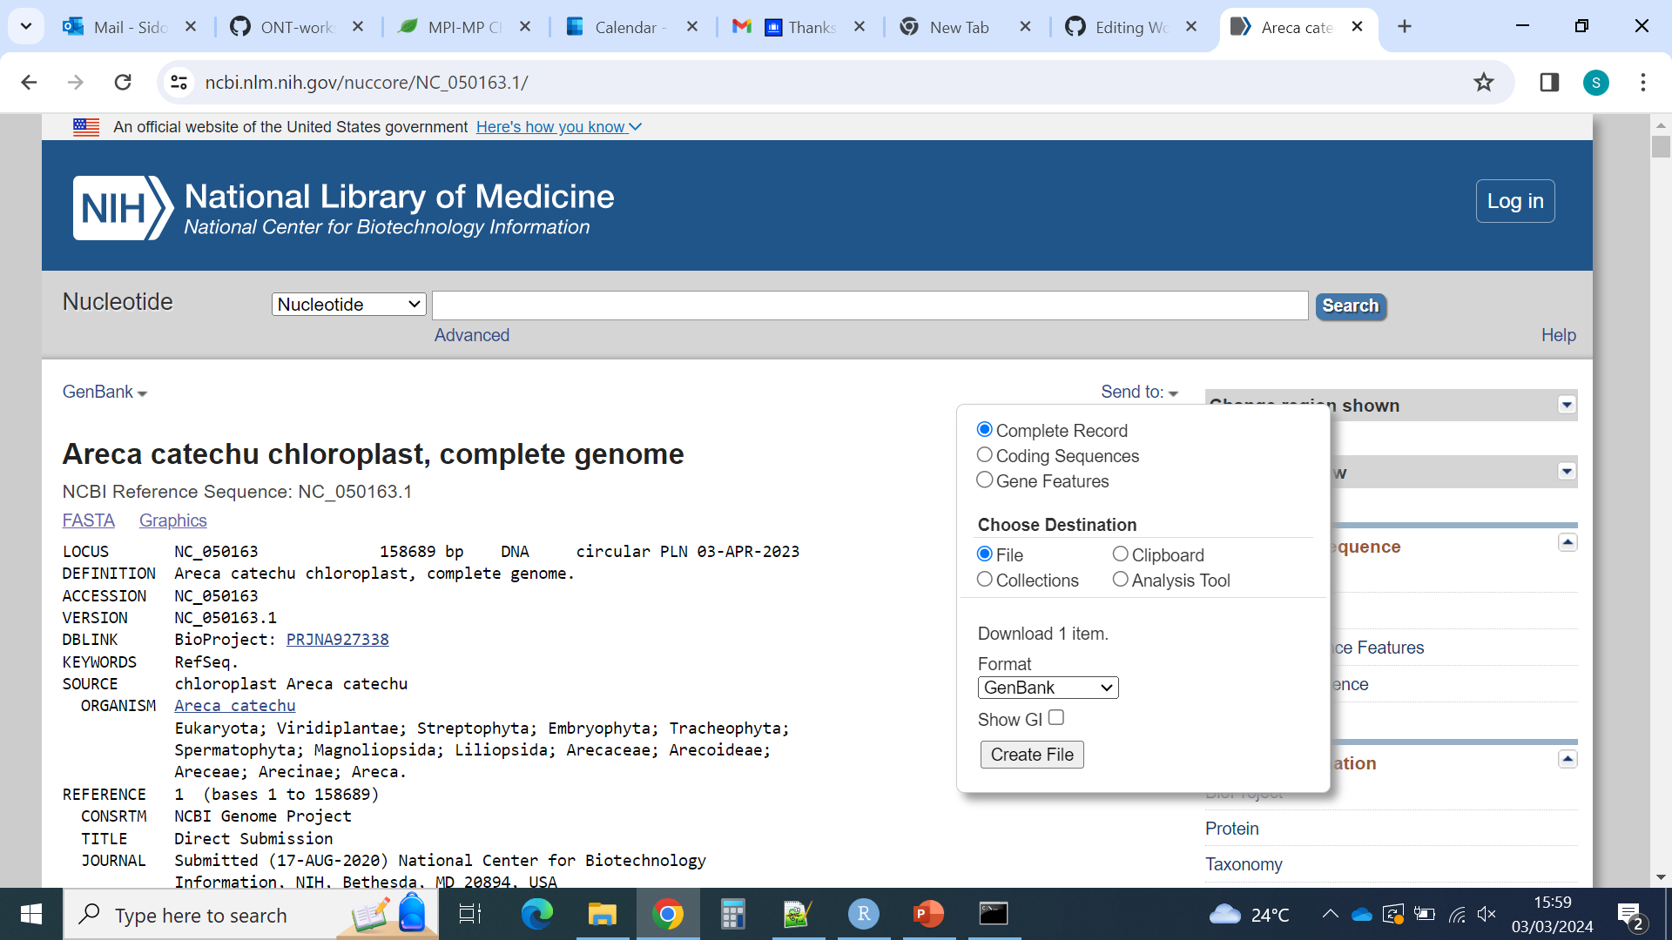

Assembling plastid regions or plastomes
Illumina reads + Hybpiper to recover specific plastid regions (and ITS)
Dowload a (well annotated) reference plastome from Genbank (and ITS reference)
Use it to make a target file for Hybpiper (for instance using custom script Parse_GB.py)
Run Hybpiper as usual

Slide 3
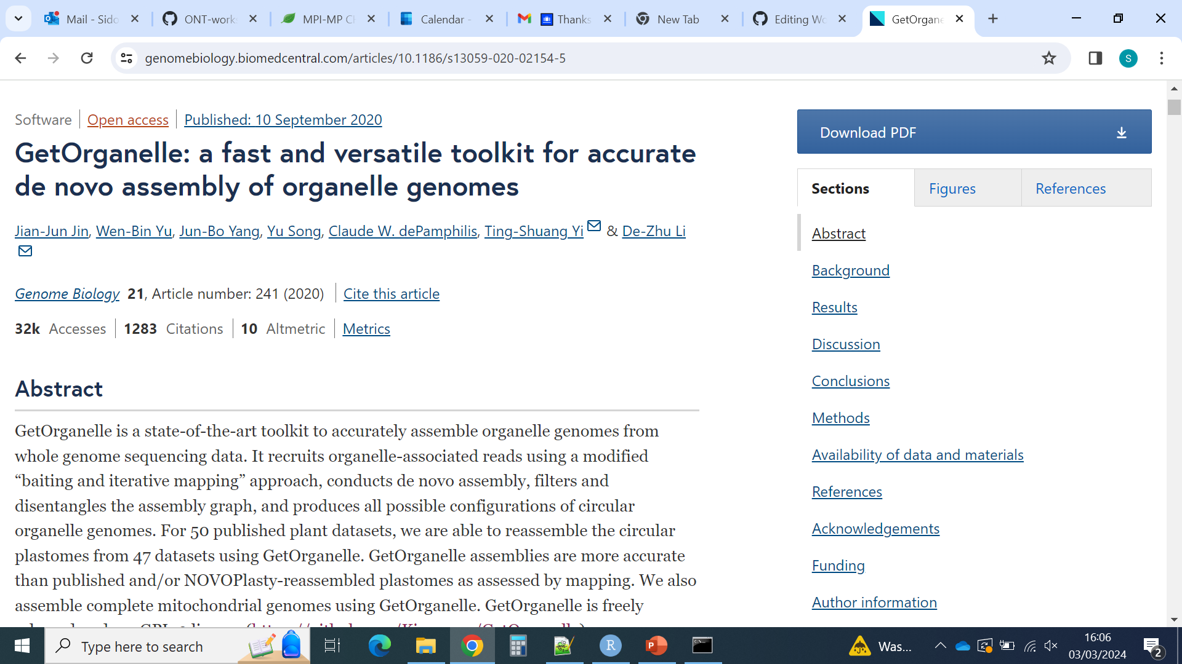
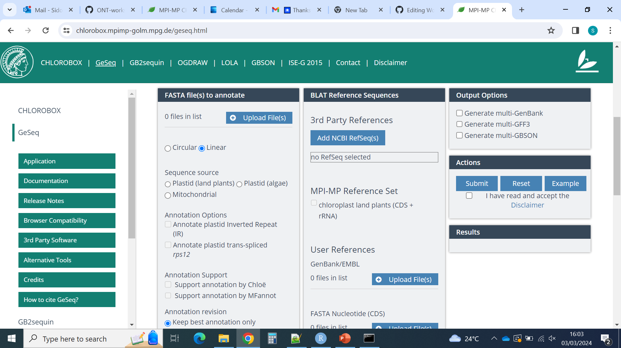
Assembling plastid regions or plastomes
Illumina reads + Hybpiper to recover specific plastid regions (and ITS)
Dowload a (well annotated) reference plastome from Genbank (and ITS reference)
Use it to make a target file for Hybpiper (for instance using custom script Parse_GB.py)
Run Hybpiper as usual
Illumina reads + Getorganelle to get a plastome
Clean your reads
Assemble plastome/plastid contigs with GetOrganelle
Annotate them with CHLOROBOX
https://github.com/Kinggerm/GetOrganelle

Slide 4
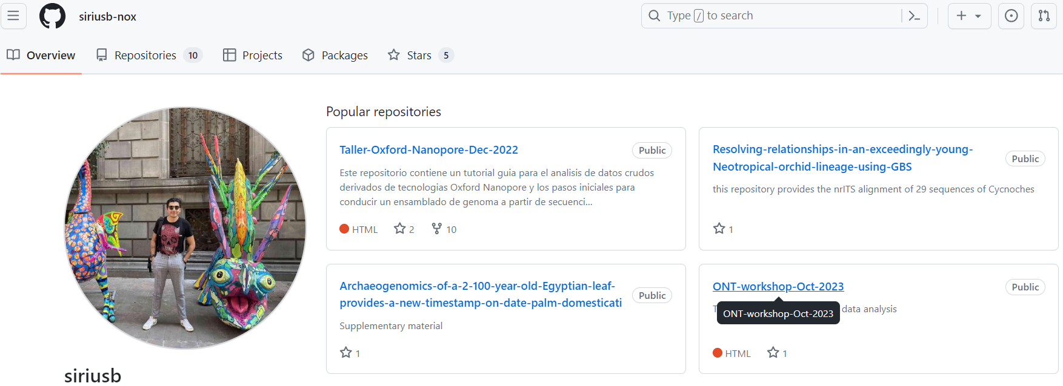
Assembling plastid regions or plastomes
Illumina reads + Hybpiper to recover specific plastid regions (and ITS)
Dowload a (well annotated) reference plastome from Genbank (and ITS reference)
Use it to make a target file for Hybpiper (for instance using custom script Parse_GB.py)
Run Hybpiper as usual
Illumina reads + Getorganelle to get a plastome
Clean your reads
Assemble plastome/plastid contigs with GetOrganelle
Annotate them with CHLOROBOX
Nanopore (+ Illumina) reads to get a plastome
See separate tutorial genome assembly
Annotate the plastome with CHLOROBOX

Slide 5
High Performance Computing

Slide 6
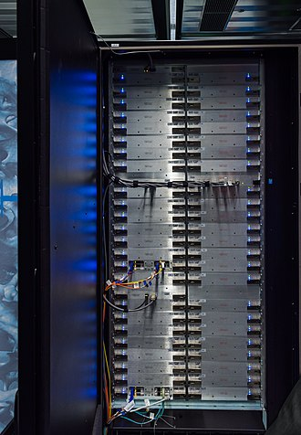
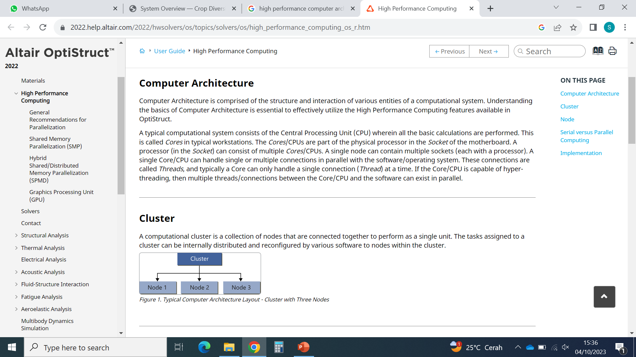
High Performance Computing
High Performance Computer = Cluster
Pictures: Wikipedia

Slide 7
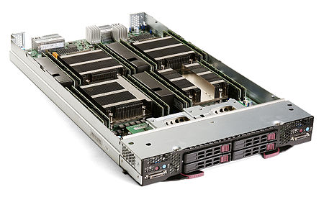
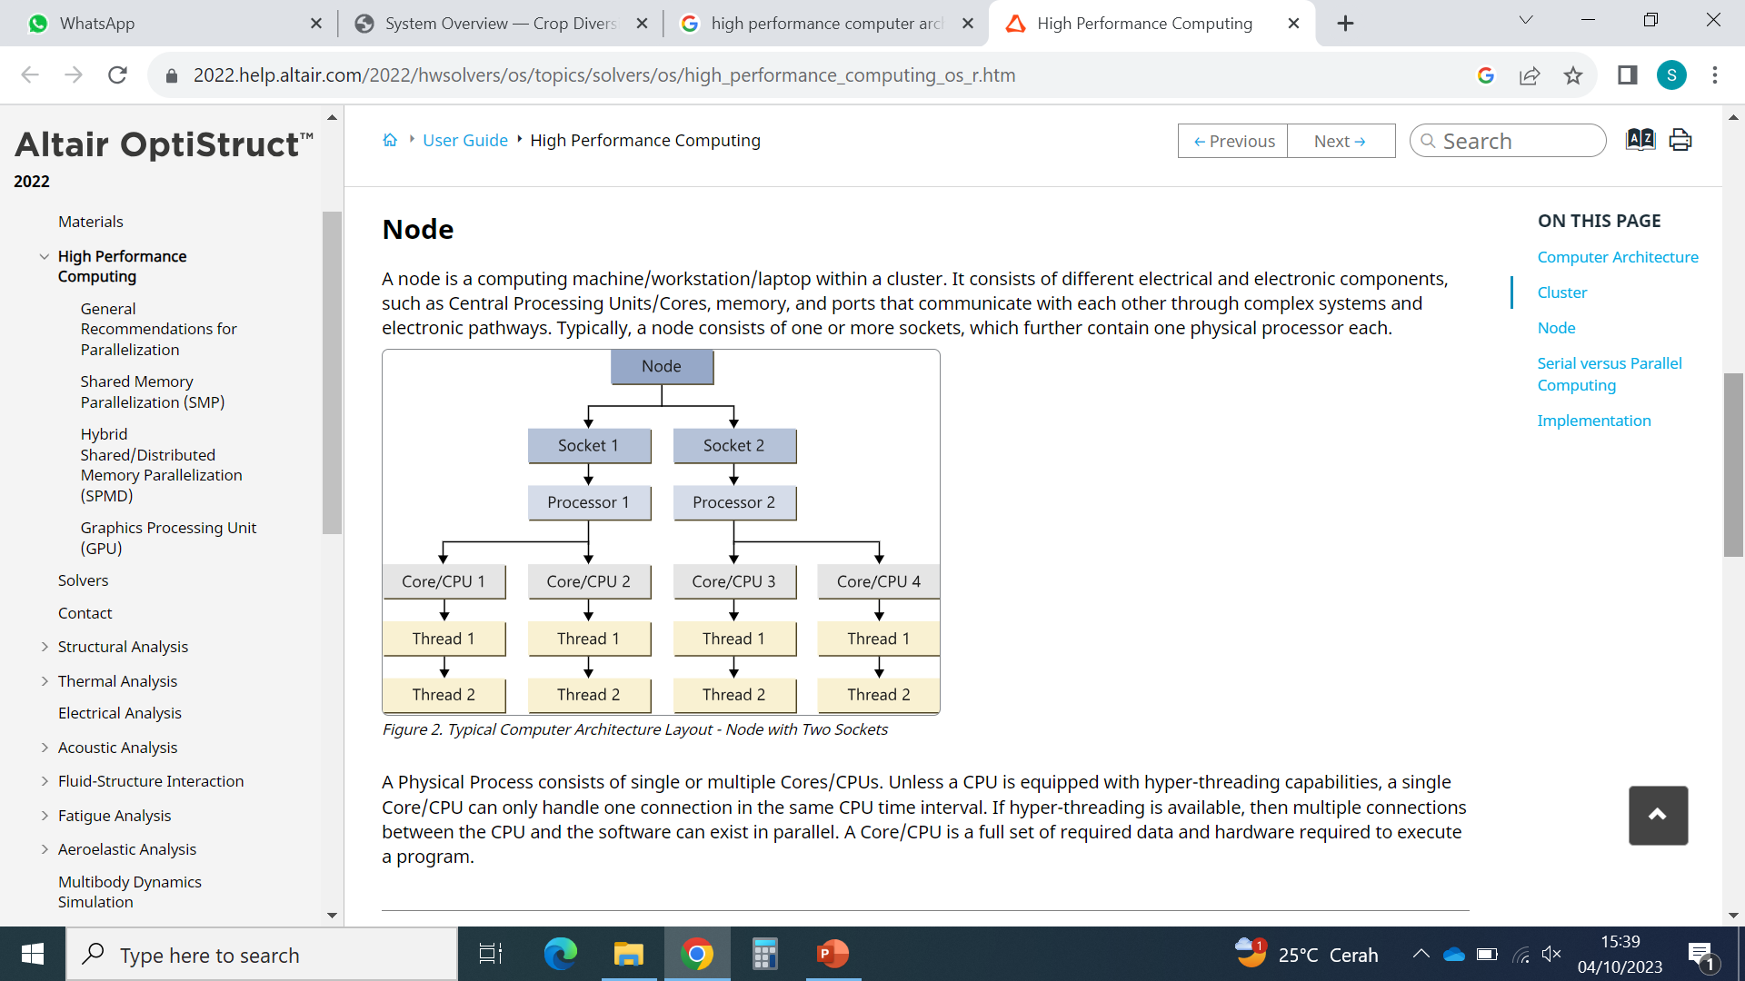
High Performance Computing
Cluster with 48*2 nodes
High Performance Computer = Cluster
Head node
Blade with 2 nodes
Pictures: Wikipedia

Slide 8

High Performance Computing
Cluster with 48*2 nodes
High Performance Computer = Cluster
Head node
Blade with 2 nodes
Processor with CPUs
Pictures: Wikipedia

Slide 9
High Performance Computing
Cluster with 48*2 nodes
High Performance Computer = Cluster
Head node
Blade with 2 nodes
Processor with CPUs
Pictures: Wikipedia

Slide 10
High Performance Computing
High Performance Computer = Cluster
Head node
Physical components
Node = computer
Cluster: group of interconnected nodes
Head node: the node to which users connect remotely
Usually small computing / storage capacity
Avoid performing analyses on the head node!
CPU (Central Processing Unit) = Core: computing unit
Virtual components
Thread: connection between the CPU and the software
Hyperthreading: 2 connections in parallel are possible

Slide 11
High Performance Computing

Slide 12
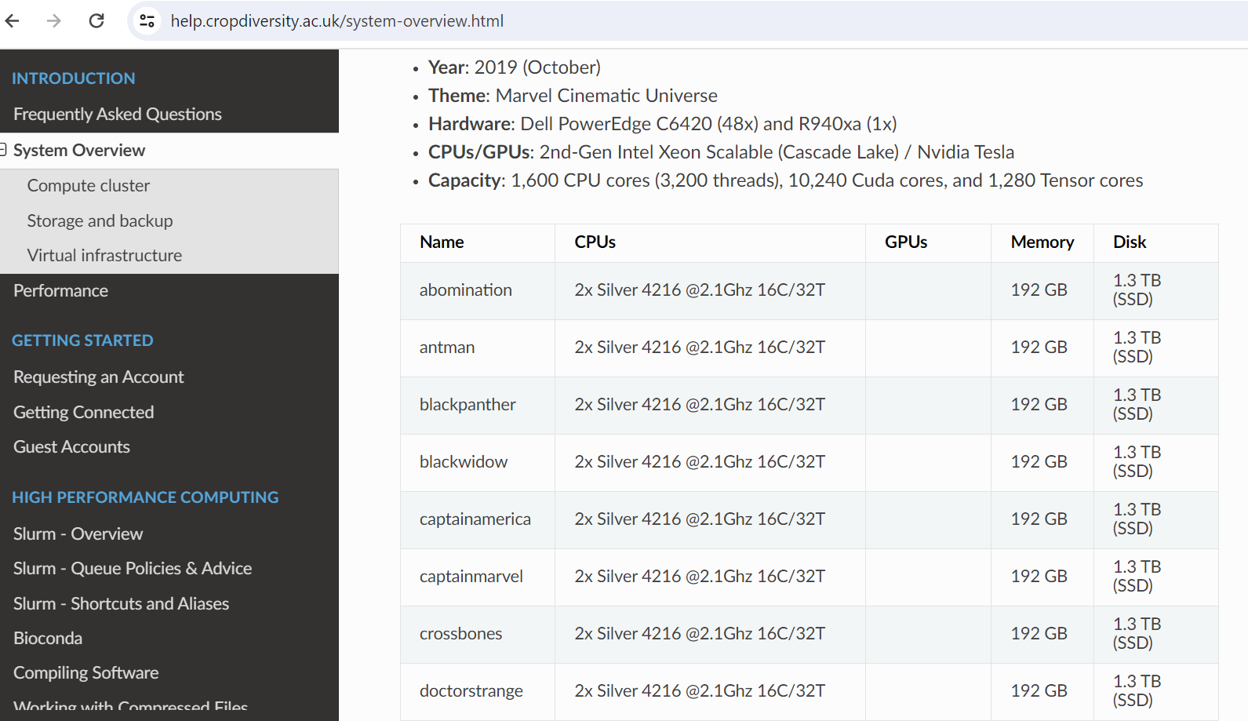
High Performance Computing - an example of cluster

Slide 13
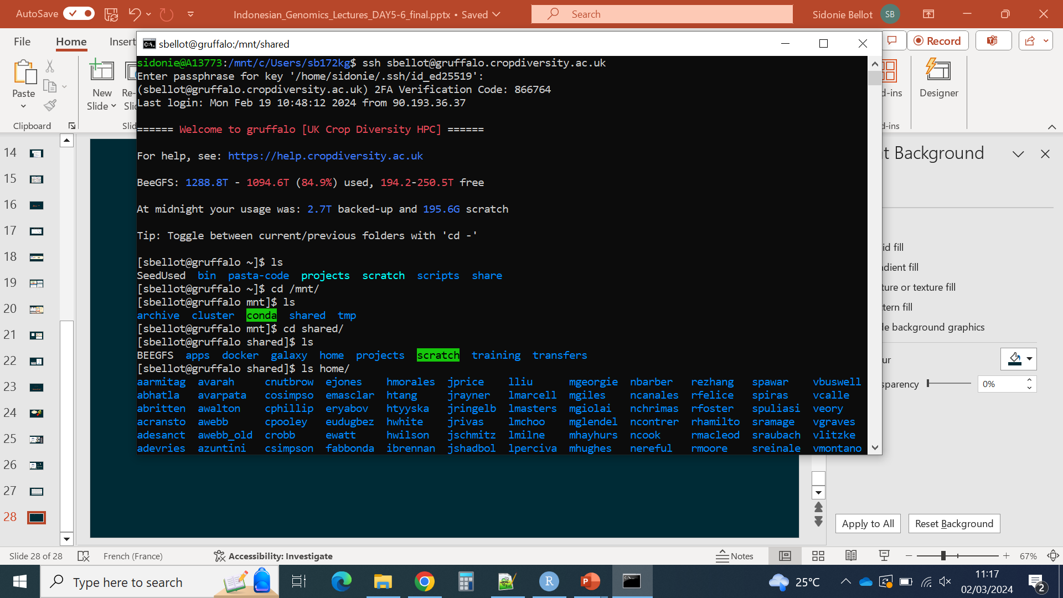
High Performance Computing - insider look

Slide 14
High Performance Computing - insider look
You are now in your computer
Connect to the HPC
ssh command + user name + HPC address
Type your password + additional code if asked

Slide 15
High Performance Computing - insider look
You are now in your computer
Connect to the HPC
You are now in the cluster
Information about the cluster
Information about your use of the cluster

Slide 16
High Performance Computing - insider look
You are now in your computer
Connect to the HPC
You are now in the cluster
Information about the cluster
Information about your use of the cluster
You are now in the cluster, in your user space (~)
You can see what is around your user space

Slide 17
High Performance Computing - insider look
You are now in your computer
Connect to the HPC
You are now in the cluster
Information about the cluster
Information about your use of the cluster
You are now in the cluster, in your user space (~)
You can see what is around your user space
Many other users have their own space
You cannot do much outside of your space

Slide 18
High Performance Computing - good practice
Save space for other users
Learn and follow recommandations about where you should store your files and data
Backup only what is necessary
Delete what you do not need
Save memory for other users
Do test runs on few samples to know how much memory you need for a task
Request only the memory you need
Use job queing and memory request systems
Learn and follow recommendations about how to submit jobs (e.g. slurm next slide)
Do not run anything intensive on the head node
If you need to run commands interractively, do not do it on the head node

Slide 19
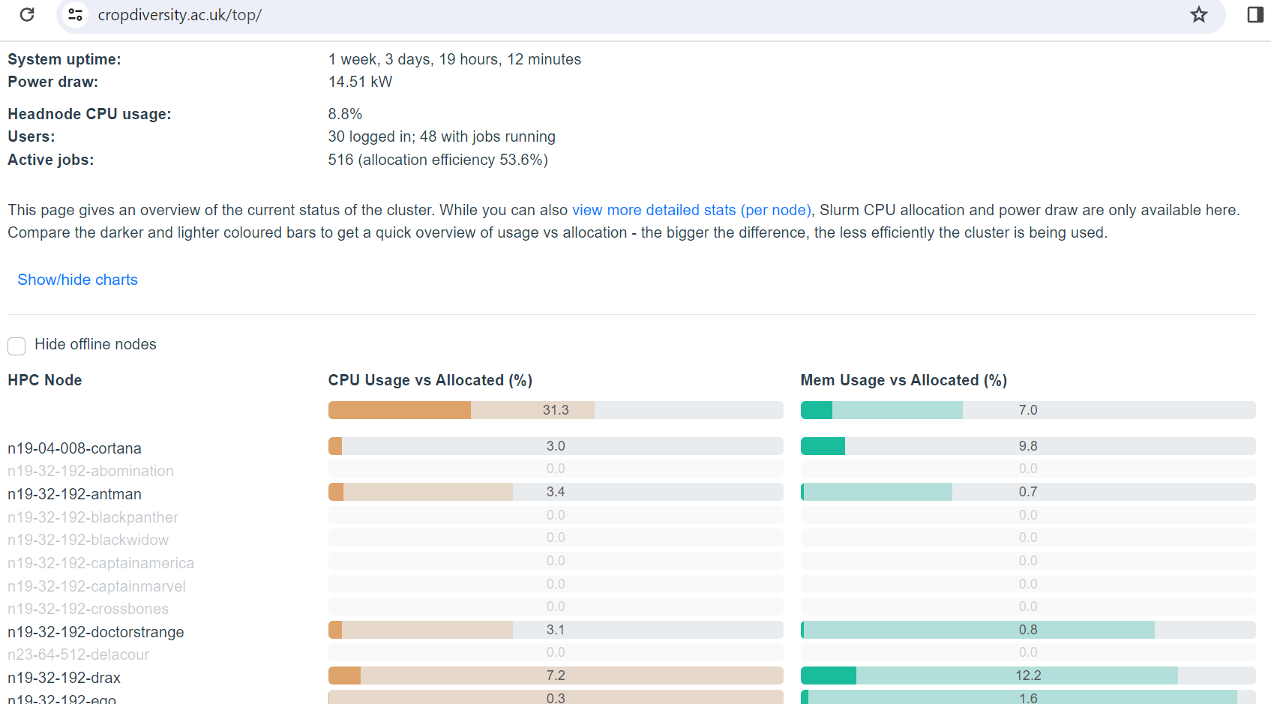
High Performance Computing - good practice

Slide 20
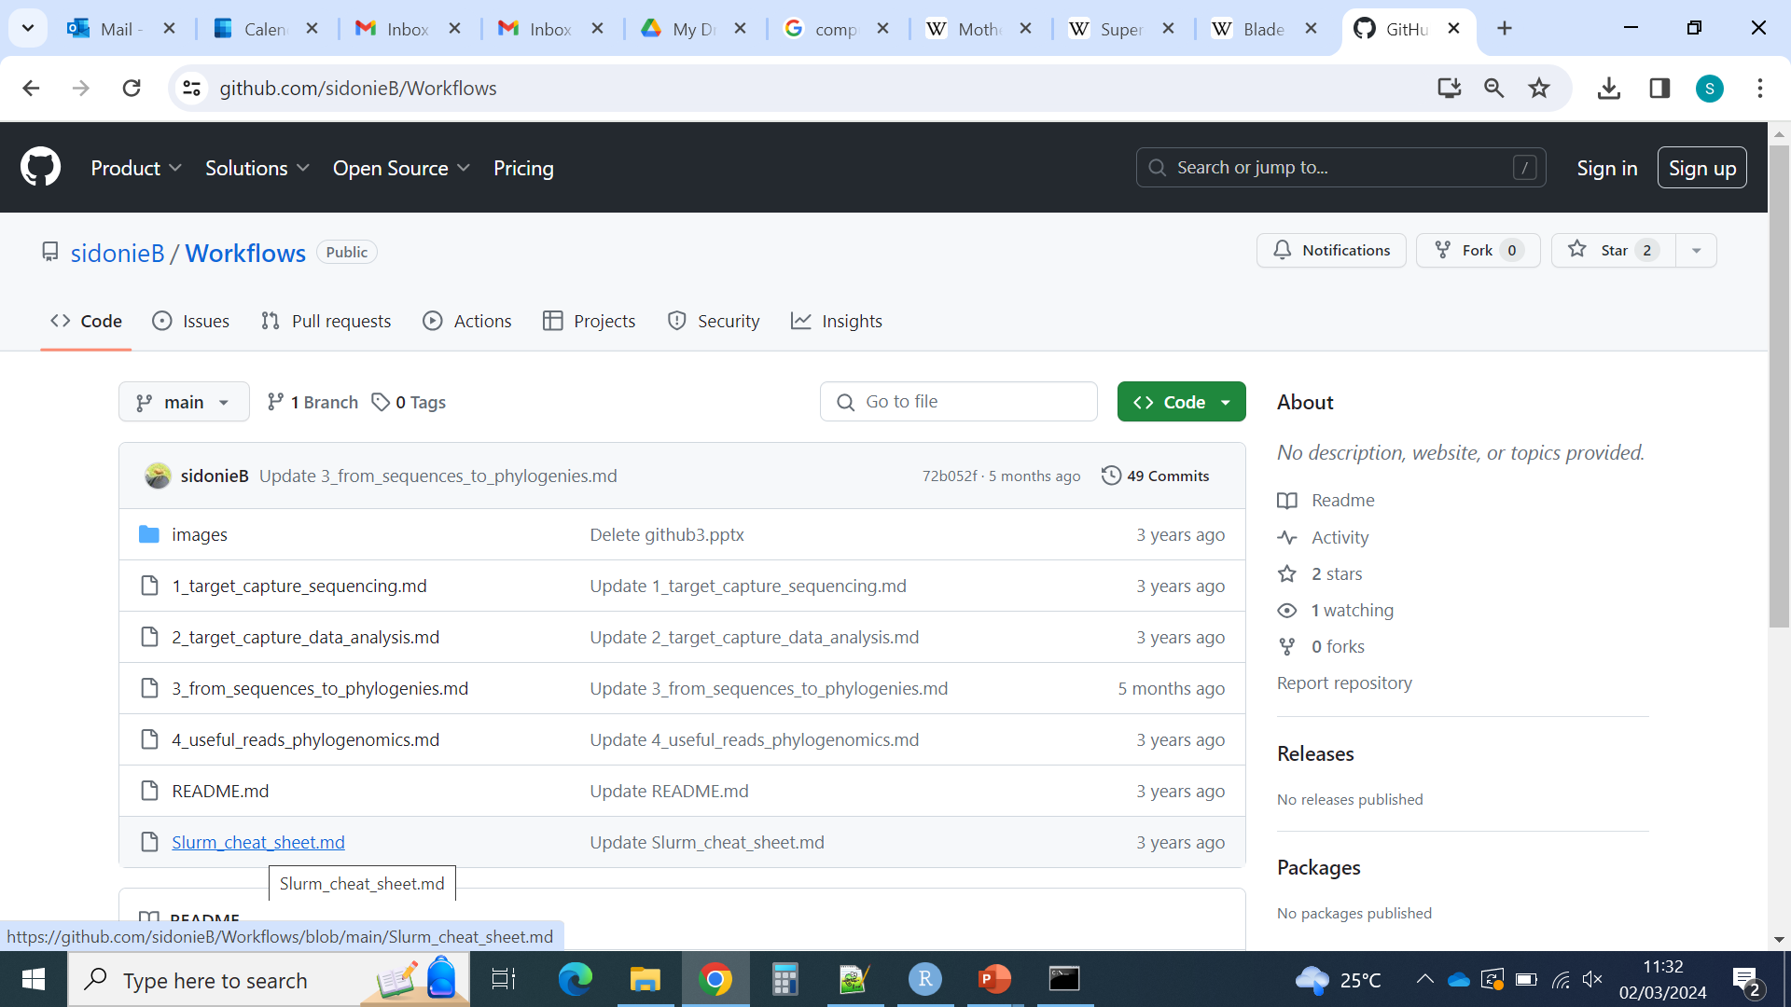

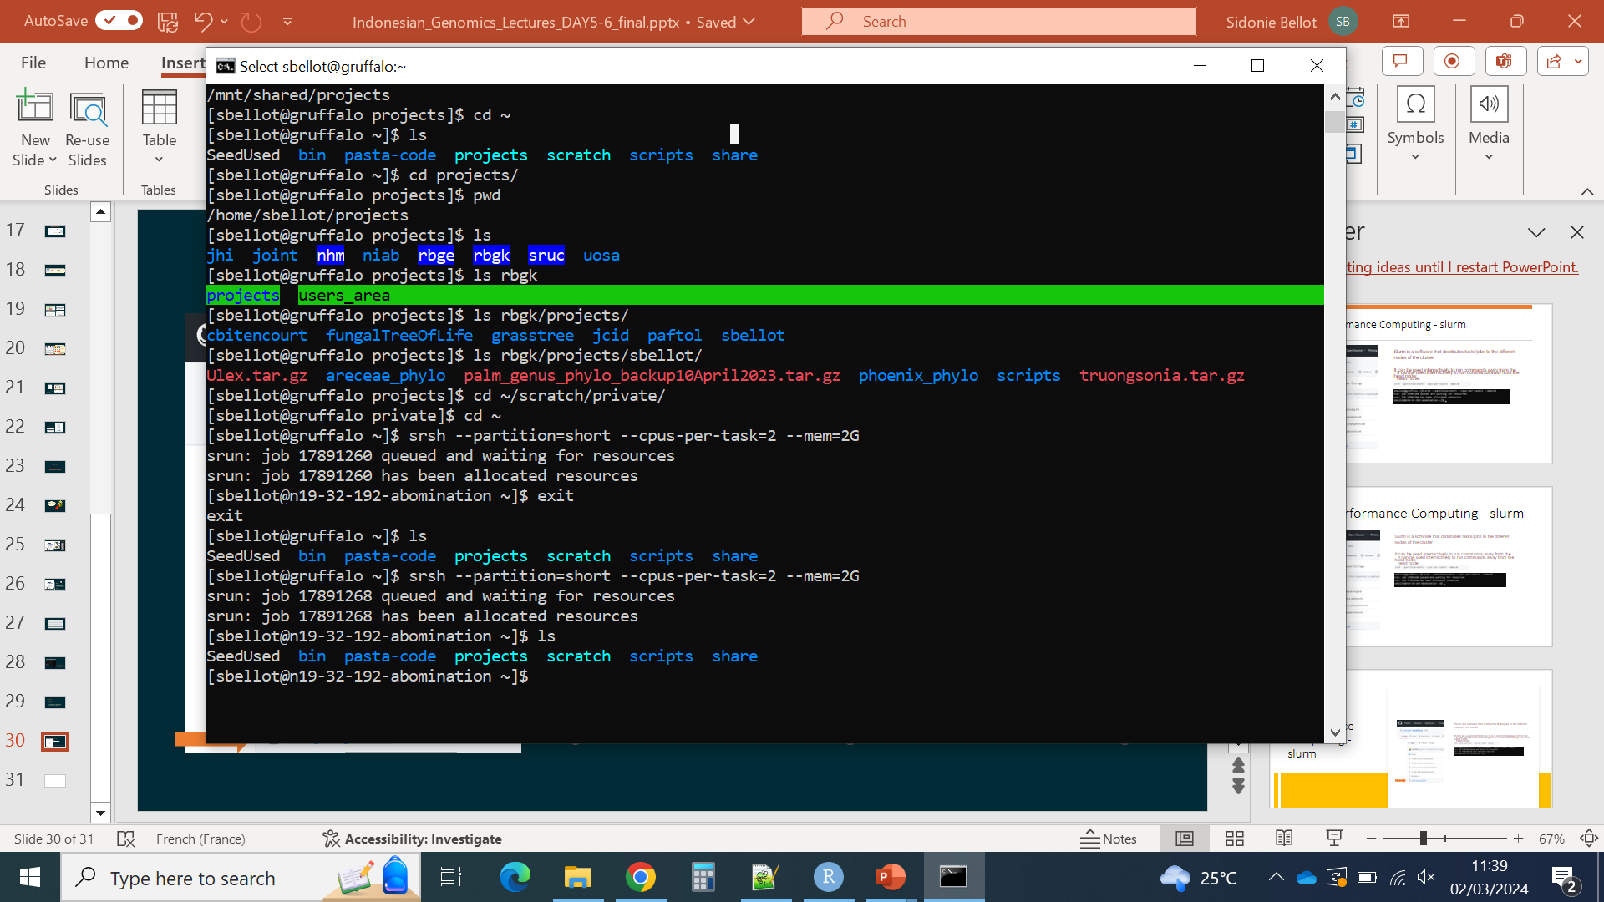
High Performance Computing - slurm
Slurm is a software that distributes tasks/jobs to the different nodes of the cluster
It can be used interractively to run commands away from the head node:
More info/help on slurm:
https://help.cropdiversity.ac.uk/slurm-overview.html (specific to one HPC)
https://slurm.schedmd.com/ (general manual)

Slide 21
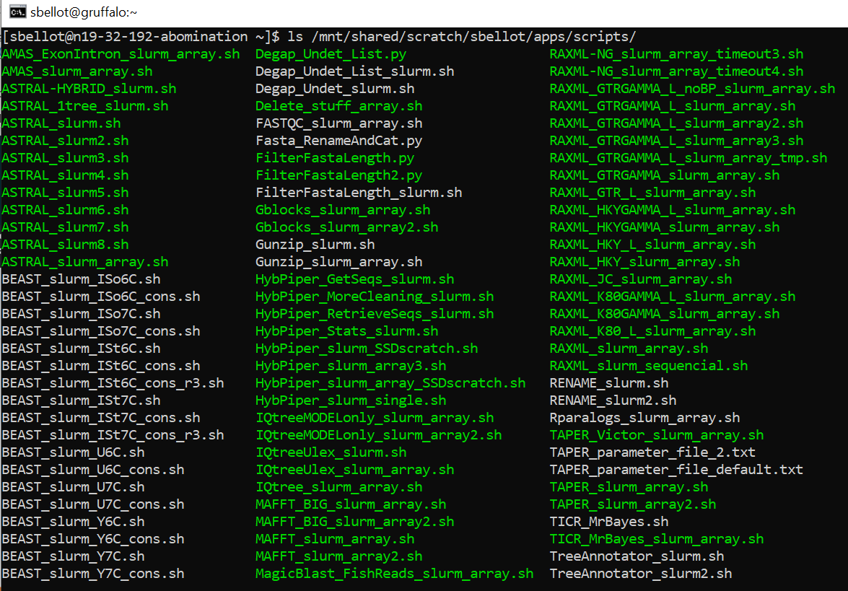
High Performance Computing - slurm
More often we use a script to run commands on one or multiple nodes

Slide 22
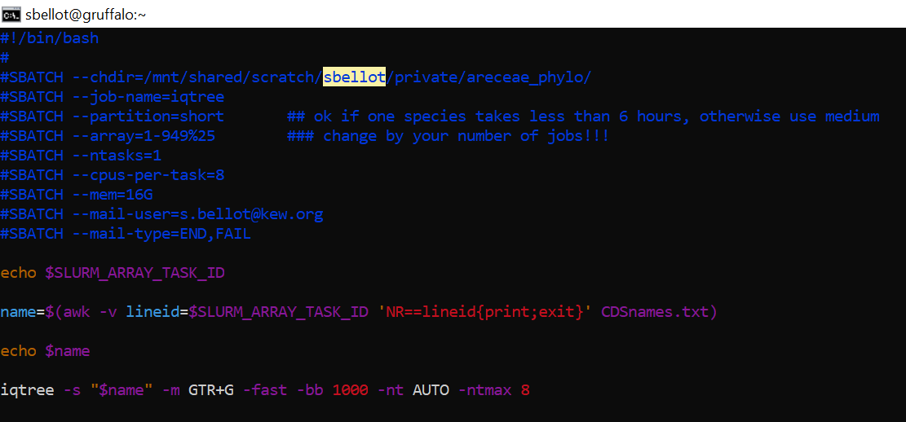
High Performance Computing - slurm
More often we use a script to run commands on one or multiple nodes:
Many scripts relevant for phylogenomics here

Slide 23
Q & A / Projects

Slide 24
Get ready for the next steps
Install paleomix
Get the toy dataset in the right place

Slide 25
Population genomics
See separate slides

